Slide 1

Climate Race
BIS 313 D: Issues in Media Studies
UW1-102
Lilia Campbell
Alex Wang
Ryan Frazier
Tim Vongpanya
Caroline Zhang
Sinead Rafferty

Slide 2
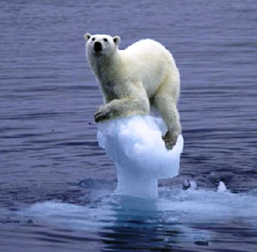
Value Proposition
Raise awareness about climate change and global warming
Introduce ways that climate change affects different ecosystems and the animals that live in them
What we can do to help save the environment and animals from negative human interactions
Create a connection between the game and human impacts on the climate that happen on a daily basis (ex: car pollution)

Slide 3
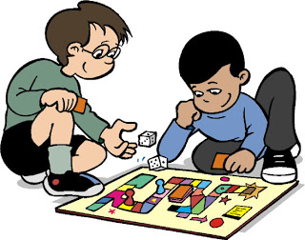
Audience Overview
Target Audience: Teenagers ages 10-14
Specifically middle schoolers learning about world climates/science
Both boys and girls
Educational game with fun:
Use in classroom for climate study
learn while playing
Play with friends anytime
Easy to play and organize (standard board game rules)
All ages, anyone can play and learn
Notes:
The nice layout and design with real pictures and cute cartoon characters will be attractive to kids.
Facts in the game are easy to understand and relate to everyday life.

Slide 4

Key Game Features
Player cards(4 cards) - These give a bio about the climate(back) and animal(front)
Forest - Owl
Desert - Cheetah
Arctic - Bearded Seal
Marine - Sea Turtle
Effect cards (Low-risk/High-risk)
Negatives
Positives
Notes:
Player cards: these give a bio about the animal that represents one of the four major habitats on earth, teaching the players about the different types of climates
Effects cards: these control the player’s movements based on a description of climate changing event both positive and negative.

Slide 5
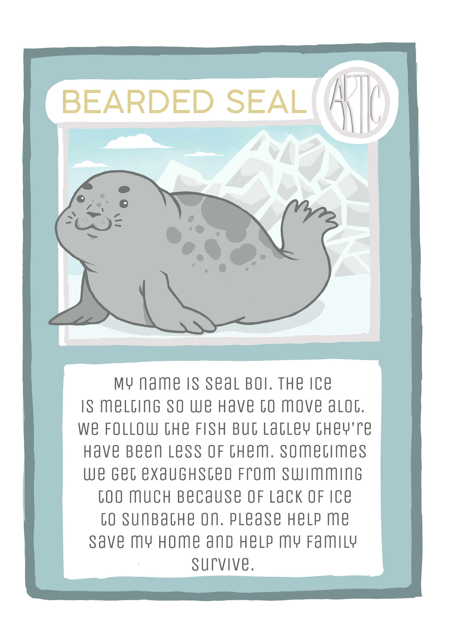
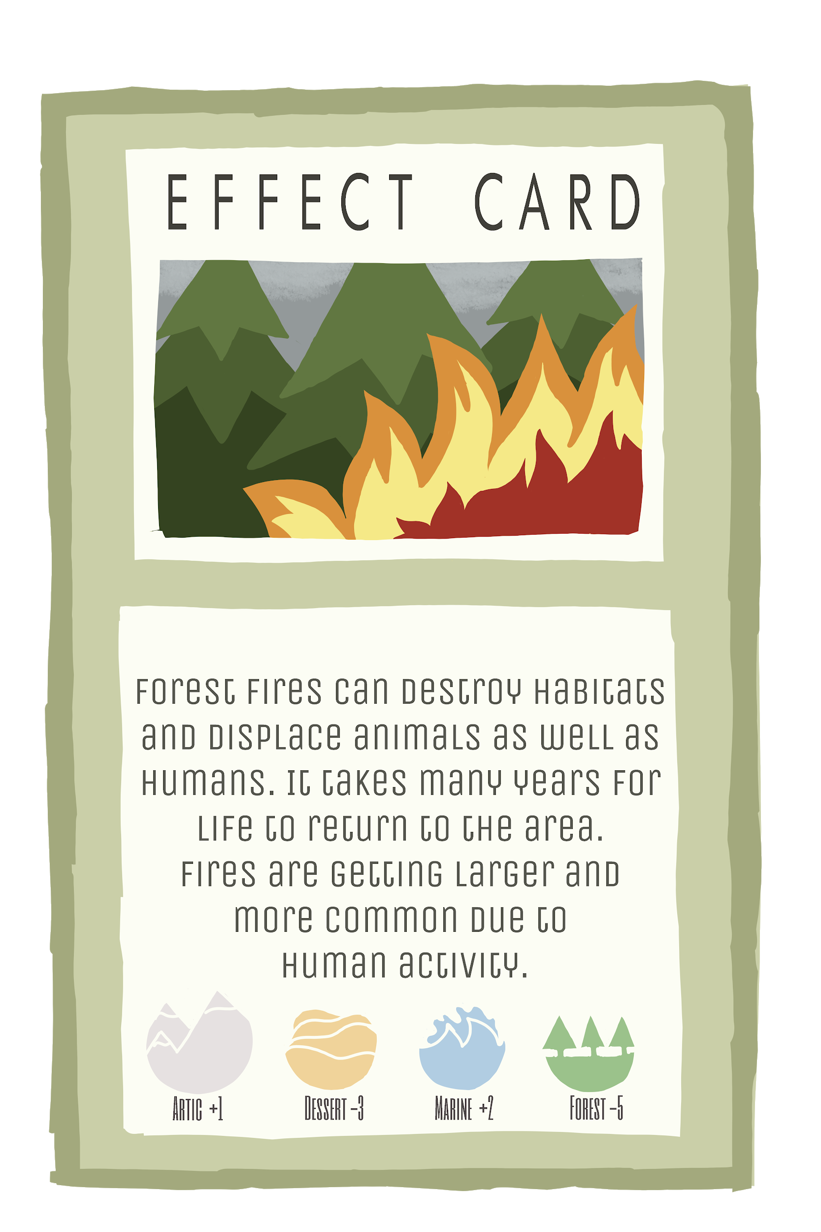
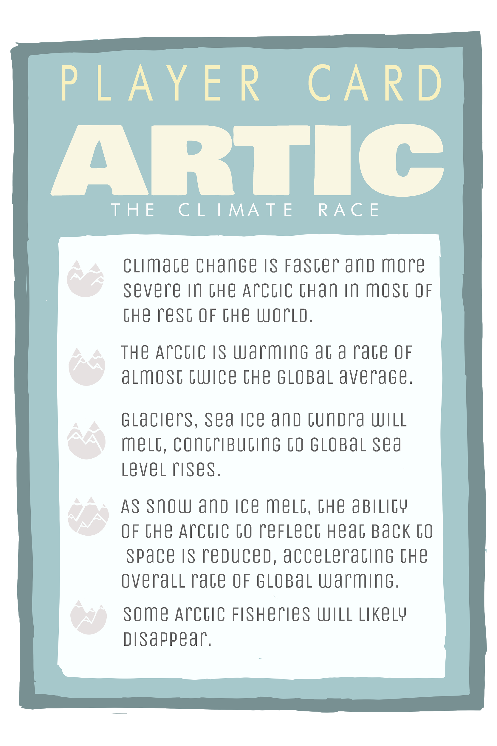
Card Designs/Layout

Slide 6
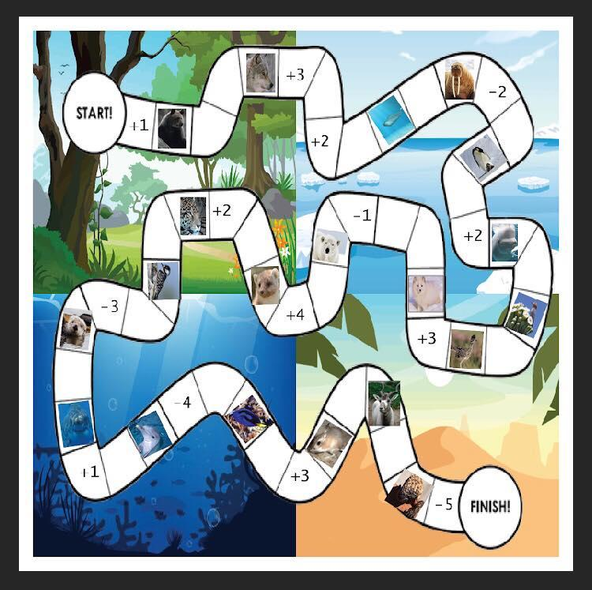
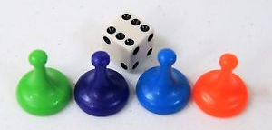
Climate Race

Slide 7
Rules of Climate Race
Each player assumes an animal representative of a habitat with colored game piece and animal bio card.
Players roll single die to see who goes first
tie goes to whoever recycled last
Normal mode VS Pro Mode
Normal Mode: unlimited rounds
Pro mode: 20 round limit
Roll single die to move across gameboard from Start to Finish
Landing on an animal image lets the player draw an effect card from either deck (choose one deck/card per turn), make sure to read the card out loud and put the card at the end of the deck.

Slide 8
THANK YOU!

